Slide 1
Reinforcement Learning
Eine „kurze“ Einführung

Slide 2



Technologien / Frameworks

Slide 3
Machine learning - Umfeld
Artificial intelligence
Machine learning
Supervised learning
Unsupervised learning
Reinforcement learning

Slide 4


Reinforcement Learning - Komponenten
Agent
Environment

Slide 5
Reinforcement Learning – Environment
Environment

Slide 6

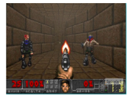
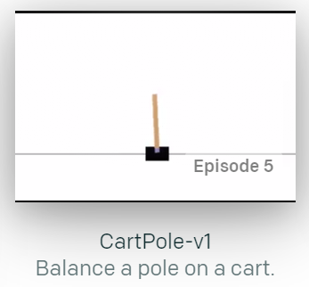
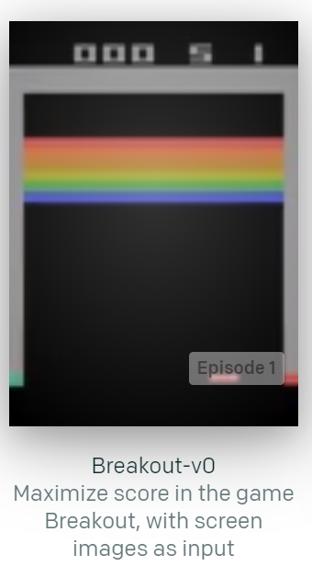
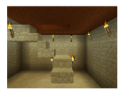
Reinforcement Learning - Environment
https://gym.openai.com/

Slide 7

Reinforcement Learning - Terminologie
Agent
Action a
State s
Reward r
0
1
2
3
4
5
+1
6
S
G
Environment
Policy
$$π$$

Slide 8


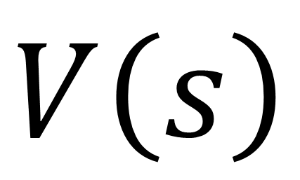


Reinforcement Learning – Der Plan
0
1
2
3
4
5
+1
6
S
G
Bellman Gleichung
$$V\left(s\right)=max\left(R\left(s,a\right)+γV\left(s^{′}\right)\right)$$
$$V\left(s\right)$$
$$α$$
$R\left(s,a\right)$ = Reward für eine Aktion aus einem bestimmten State
$V\left(s^{′}\right)$ = Value des nächsten States
$$γ=Discount Rate \left(gamma\right)$$

Slide 9






Reinforcement Learning – Der Plan
0
1
2
3
4
5
+1
6
S
G
$$V\left(s\right)=max\left(R\left(s,a\right)+γV\left(s^{′}\right)\right)$$
$$α$$
$$γ=0.9$$
$R\left(s,a\right)$ = 1
$V\left(s^{′}\right)$ = 0
$V\left(s\right)=\left(1+0.9 ∗0\right)$ $=$ 1
V=0
V=1
V=0

Slide 10



Reinforcement Learning – Der Plan
0
1
2
3
4
5
+1
6
S
G
$$V\left(s\right)=max\left(R\left(s,a\right)+γV\left(s^{′}\right)\right)$$
$$α$$
$$γ=0.9$$
$R\left(s,a\right)$ = 0
$V\left(s^{′}\right)$ = 1
$V\left(s\right)=\left(0+0.9 ∗1\right)$ $=$ 0.9
V=0
V=0.66
V=0.73
V=0.81
V=0.9
V=1
V=0

Slide 11


Reinforcement Learning – Der Plan
0
1
2
3
4
5
+1
6
S
G
$$V\left(s\right)=max\left(R\left(s,a\right)+γV\left(s^{′}\right)\right)$$
$$α$$
$$V_{π}\left(s\right)$$
V=0
V=0.66
V=0.73
V=0.81
V=0.9
V=1
V=0
Policy
$$π$$

Slide 12

Reinforcement Learning – Coding

Slide 13
Reinforcement Learning – MDP
Deterministisch
Stochastisch
100% Wahrscheinlichkeit
20%
60%
20%

Slide 14


Reinforcement Learning – MDP
Markow-Entscheidungsproblem / Markow decision process (MDP)
Markow-Annahme
Wahrscheinlichkeit $P$ einen Zustand $s^{′}$zu erreichen
ist nur abhängig vom vorherigen State $s$
$T\left(s,a,s^{′}\right)=P(s^{′}|s,a)$
20%
60%
20%
Transitionswahrscheinlichkeit

Slide 15






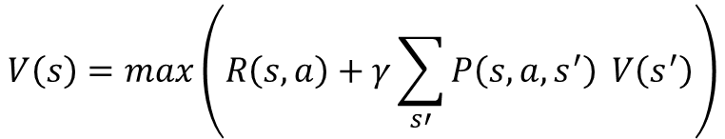
Reinforcement Learning – Bellman + MDP
$0.2 \text{∗} V\left(s_{1}^{′}\right)$ + 0.6 * $V\left(s_{2}^{′}\right)$ + 0.2 * $V\left(s_{3}^{′}\right)$
$$s_{1}^{′}$$
$$s_{2}^{′}$$
$$s_{3}^{′}$$
$$V\left(s\right)=max\left(R\left(s,a\right)+γV\left(s^{′}\right)\right)$$
$$α$$
$$V\left(s\right)=max\left(R\left(s,a\right)+γ\sum_{s′}{P\left(s,a,s^{′}\right)} V\left(s^{′}\right)\right)$$
20%
60%
20%
$$α$$

Slide 16
Reinforcement Learning – Coding

Slide 17
Reinforcement Learning
$$V\left(s\right)=max\left(R\left(s,a\right)+γ\sum_{s′}{P\left(s,a,s^{′}\right)} V\left(s^{′}\right)\right)$$
state-value function (V function)
$$α$$
Was ist von diesem State aus zu erwarten?
action-value function (Q)
Was kann ich von diesem State aus erwarten, wenn ich eine bestimmte Aktion ausführe?

Slide 18


















Reinforcement Learning – action - value
Actions:
0 – left
1 – right
2 – up
3 – down
state-value
action-value
$$V\left(s_{0}\right)$$
$$V\left(s_{1}\right)$$
$$V\left(s_{2}\right)$$
$$Q\left(s_{5},a_{2}\right)$$
$$V\left(s_{4}\right)$$
$$V\left(s_{6}\right)$$
$$Q\left(s_{5},a_{0}\right)$$
$$Q\left(s_{5},a_{1}\right)$$
$$Q\left(s_{5},a_{3}\right)$$
$0.$44
$$0.25$$
$$0.56$$
$$0.82$$
$0.0$3
$$0.21$$
$$0.11$$
$$0.09$$
$$0$$

Slide 19

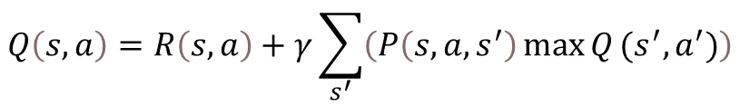

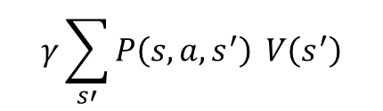

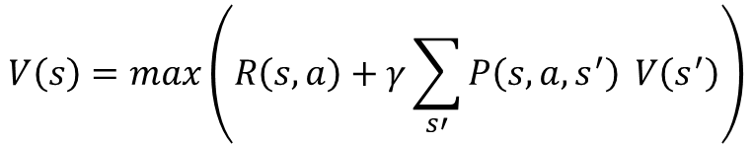


Reinforcement Learning – Q function
$$V\left(s\right)=max\left(R\left(s,a\right)+γ\sum_{s′}{P\left(s,a,s^{′}\right)} V\left(s^{′}\right)\right)$$
$$α$$
$$V\left(s_{5}\right)$$
$$γ\sum_{s′}{P\left(s,a,s^{′}\right)} V\left(s^{′}\right)$$
$$Q\left(s,a\right)=R\left(s,a\right)+γ\sum_{s^{′}}{\left(P\left(s,a,s^{′}\right)\max{Q}(s^{′},a^{′})\right)}$$
$$Q\left(s,a\right)=$$
$$R\left(s,a\right)+$$
$$Q\left(s_{5},a_{2}\right)$$
$$a^{′}$$

Slide 20
Reinforcement Learning – Coding

Slide 21

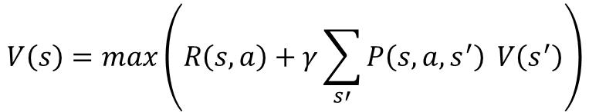

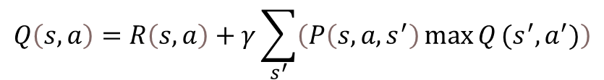
Reinforcement Learning – YEEESSSSSS
$$V\left(s\right)=max\left(R\left(s,a\right)+γ\sum_{s′}{P\left(s,a,s^{′}\right)} V\left(s^{′}\right)\right)$$
$$α$$
$$Q\left(s,a\right)=R\left(s,a\right)+γ\sum_{s^{′}}{\left(P\left(s,a,s^{′}\right)\max{Q}(s^{′},a^{′})\right)}$$
$$a^{′}$$

Slide 22

Reinforcement Learning – NOOOOOOO
$$V\left(s\right)=max\left(R\left(s,a\right)+γ\sum_{s′}{P\left(s,a,s^{′}\right)} V\left(s^{′}\right)\right)$$
$$α$$
$$Q\left(s,a\right)=R\left(s,a\right)+γ\sum_{s^{′}}{\left(P\left(s,a,s^{′}\right)\max{Q}(s^{′},a^{′})\right)}$$
$$a^{′}$$

Slide 23




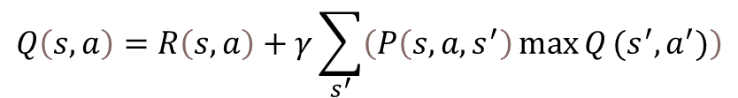





Reinforcement Learning – Q learning
$$Q\left(s,a\right)=R\left(s,a\right)+γ\sum_{s^{′}}{\left(P\left(s,a,s^{′}\right)\max{Q}(s^{′},a^{′})\right)}$$
stochastisch
$$a^{′}$$
$$Q\left(s,a\right)=R\left(s,a\right)+γ\max{Q}(s^{′},a^{′})$$
deterministisch
$$a^{′}$$
Initial
nach Aktion
+1
$$Q\left(s,a\right)$$
$$R\left(s,a\right)+γ\max{Q}(s^{′},a^{′})$$
$$a^{′}$$
TD (Temporal Difference)
$$TD\left(a,s \right)=$$
$$R\left(s,a\right)+γ\max{Q}\left(s^{′},a^{′}\right)$$
$$−Q\left(s,a\right)$$
$$Q\left(s_{5},a_{3}\right)$$
$$a^{′}$$

Slide 24

Reinforcement Learning – Q learning
TD Target
TD Error
$$TD\left(a,s \right)=R\left(s,a\right)+γ\max{Q}\left(s^{′},a^{′}\right)−Q\left(s,a\right)$$
$$a^{′}$$

Slide 25




Reinforcement Learning – Q learning
$$TD\left(a,s \right)=R\left(s,a\right)+γ\max{Q}\left(s^{′},a^{′}\right)−Q_{t−1}\left(s,a\right)$$
$$TD\left(a,s \right)=R\left(s,a\right)+γ\max{Q}\left(s^{′},a^{′}\right)−Q\left(s,a\right)$$
$$a^{′}$$
$α$ = learning Rate
$$a^{′}$$
$t$ = time
$$Q_{t}\left(s,a\right)=Q_{t−1}\left(s,a\right)+α{TD}_{t}\left(a,s\right)$$
$$Q\left(s,a\right)=Q\left(s,a\right)+αTD\left(a,s\right)$$
$$Q_{t}\left(s,a\right)= Q_{t−1}\left(s,a\right)+α(R\left(s,a\right)+γ\max{Q}\left(s^{′},a^{′}\right)−Q_{t−1}\left(s,a\right))$$
$$a^{′}$$

Slide 26

Reinforcement Learning – Q learning
$$TD\left(a,s \right)=R\left(s,a\right)+γ\max{Q}\left(s^{′},a^{′}\right)−Q_{t−1}\left(s,a\right)$$
$$a^{′}$$
$α$ = learning Rate
$t$ = time
$$Q_{t}\left(s,a\right)=Q_{t−1}\left(s,a\right)+α{TD}_{t}\left(a,s\right)$$
$α$ = 1
$$Q_{t}\left(s,a\right)= Q_{t−1}\left(s,a\right)+α(R\left(s,a\right)+γ\max{Q}\left(s^{′},a^{′}\right)−Q_{t−1}\left(s,a\right))$$
$$a^{′}$$
$$Q_{t}\left(s,a\right)= R\left(s,a\right)+γ\max{Q}\left(s^{′},a^{′}\right)$$
Q – value wird immer komplett ersetzt !
$$a^{′}$$

Slide 27


Reinforcement Learning – Q learning
$$TD\left(a,s \right)=R\left(s,a\right)+γ\max{Q}\left(s^{′},a^{′}\right)−Q_{t−1}\left(s,a\right)$$
$$a^{′}$$
$α$ = learning Rate
$t$ = time
$$Q_{t}\left(s,a\right)=Q_{t−1}\left(s,a\right)+α{TD}_{t}\left(a,s\right)$$
$α$ = 0
$$Q_{t}\left(s,a\right)= Q_{t−1}\left(s,a\right)+α(R\left(s,a\right)+γ\max{Q}\left(s^{′},a^{′}\right)−Q_{t−1}\left(s,a\right))$$
$$a^{′}$$
$$Q_{t}\left(s,a\right)=Q_{t−1}\left(s,a\right)$$
Q – value ist immer der vorherige – nichts wird gelernt !

Slide 28

Reinforcement Learning – Q learning
$$TD\left(a,s \right)=R\left(s,a\right)+γ\max{Q}\left(s^{′},a^{′}\right)−Q_{t−1}\left(s,a\right)$$
$$a^{′}$$
$α$ = learning Rate
$t$ = time
$$Q_{t}\left(s,a\right)=Q_{t−1}\left(s,a\right)+α{TD}_{t}\left(a,s\right)$$
0 < $α$ < 1
$$Q_{t}\left(s,a\right)= Q_{t−1}\left(s,a\right)+α(R\left(s,a\right)+γ\max{Q}\left(s^{′},a^{′}\right)−Q_{t−1}\left(s,a\right))$$
$$a^{′}$$

Slide 29
Reinforcement Learning – Coding

Slide 30


Reinforcement Learning – Exploration vs Expolitation
Exploitation
Wähle die beste (gelernte) Action aus diesem State. action = $\max{Q}\left(s\right)$
Exploration
G
Wähle eine andere Aktion – erforsche das Environment.
Exploitation
Exploration
Decay $ε$ - Greedy Policy

Slide 31
Reinforcement Learning – Final Coding

